Slide 1




Monitor & Improve OEE
With One Easy-To-Use Interface
Complete Plug-and-Play Application
Realtime & Historical Information
User-Friendly and
Mobile Responsive
01
Notes:
Today I want to show you the Ignition Launchpad OEE Project: an easy-to-use, plug-and-play application that provides instant access to all your realtime and historical data through a user-friendly, factory-ready, and fully responsive interface.

Slide 2
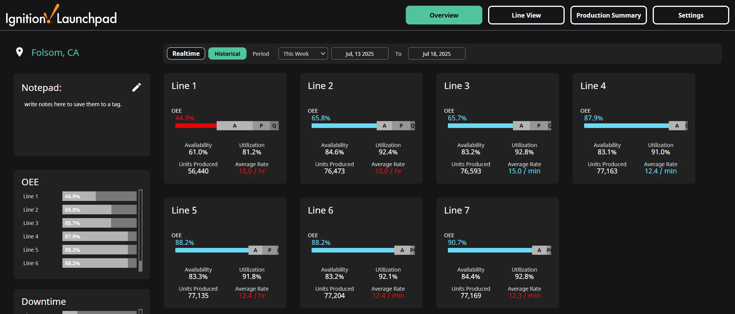

Your Operation’s OEE Metrics...Visualized
02
Notes:
This project offers detailed visibility into target rates, shifts, top production counts, and more.
It's pre-built and ready to be easily integrated with your line or machine data to start streamlining and improving your processes.
It can easily be configured to monitor many production lines, whether you want insights on 7 lines or 77 lines.
But before we get deeper into this dashboard, let's talk a little about the software it's built with.

Slide 3














Powered By
The Industrial Automation Platform
Unlimited Licensing Model
Server-Centric Web-Deployment
Modular
Configurability
Cross-Platform Compatibility
Connects To Any Major
PLC & Database
Universal Designer
Built on Open Standard Technologies
Rapid Development and Deployment
03
Notes:
Ignition is an industrial automation platform that enables you to collect all your data, design any kind of industrial application, and instantly web-deploy clients to anyone, anywhere — without limits.
Developed by Inductive Automation, the platform is built upon several unique features for the automation software space:
An unlimited licensing model that really is unlimited — we'll dive more into that shortly.
A server-centric web-deployment model that empowers you to integrate Ignition into flexible, scalable SCADA architectures.
Ignition has a full range of software modules to develop virtually any kind of industrial application.
It can be installed on any major operating system including mobile OSes like iOS and Android.
Ignition comes with a bundle of drivers for easy connection to any major PLC & Database.
It features an integrated designer tool to with an easy-to-use interface, endless customization, and includes unlimited design clients.
Ignition is built on trusted open technologies like SQL, Python, OPC UA, and MQTT.
The platform gives you all the tools and drivers you need in one place to rapidly develop and deploy any application.

Slide 4



Unlimited Tags
Unlimited Screens
LICENSING MODEL
What’s In
Unlimited?
Unlimited Users
Unlimited Connections
04
Notes:
So what's in Ignition's unlimited licensing model?
Some industrial automation software companies still charge for every client and every tag.
Ignition is different. It's is sold by the server and one server license gives you an unlimited number of clients, tags, and connections so you can build the exact system you need.

Slide 5
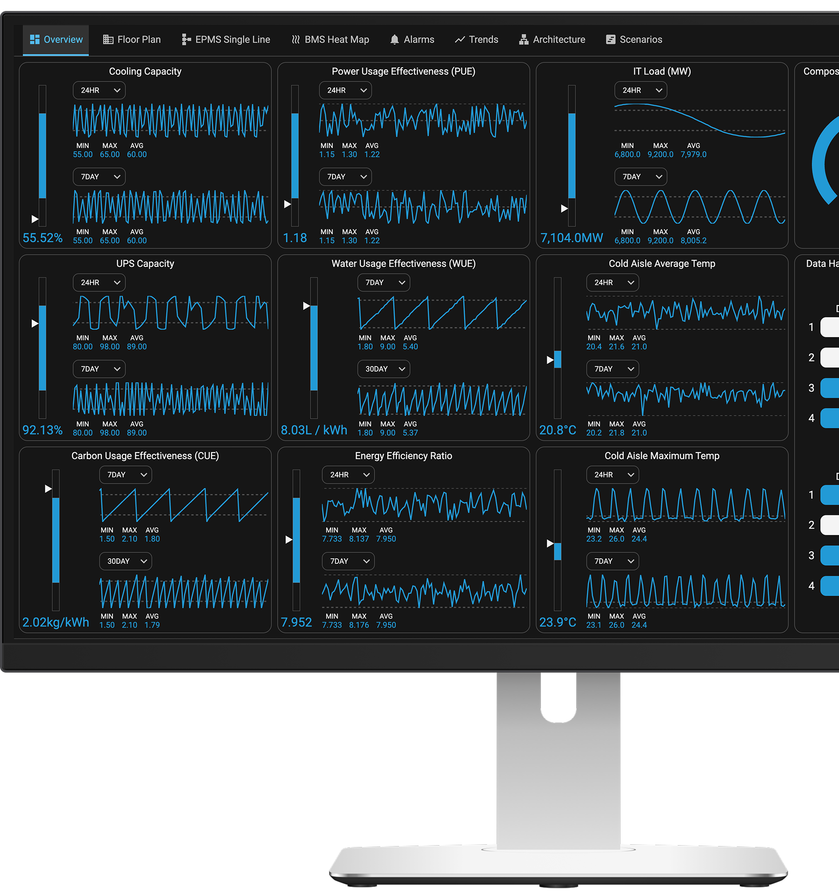
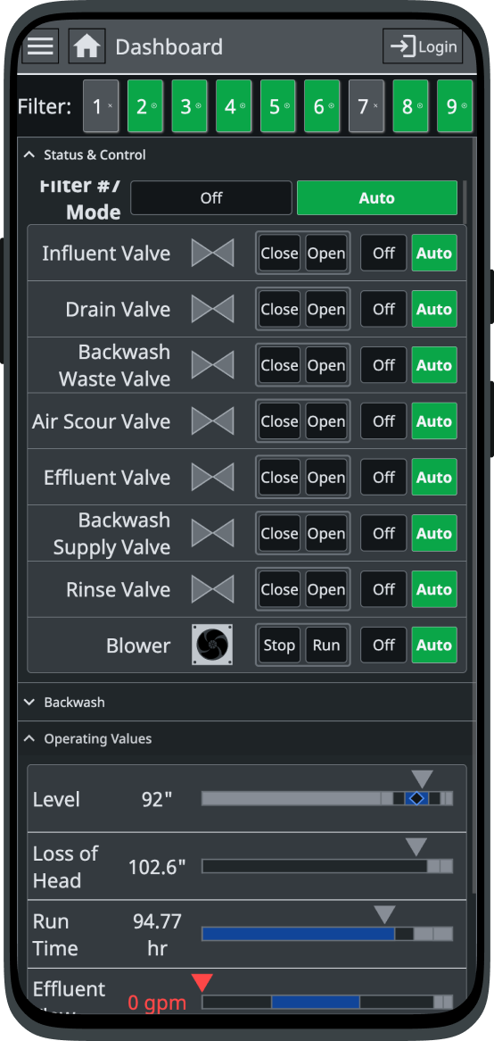
Rapidly Build Any
Industrial Application
SCADA, HMI, MES, Enterprise, Digital Transformation, Data Ops, IIoT, and More
Manufacturing, Automotive, Aerospace, Data Centers, Food & Bev, Solar, Pharmaceuticals, and More
Fast and Easy Development
Flexible and Scalable Architectures
Notes:
Ignition is also not a pre-set software package that's only viable for a specific set of use cases.
With the platform, you can pick and choose modules built by Inductive Automation to build the exact solution you need — from SCADA, HMI, and MES applications to IIoT, UNS solutions, Data Ops, and more.
And because of its modular and server-based structure, you can easily add features and scale your architecture as you go.
The customization, flexibility, and affordability it offers is why Ignition is used in practically every industry, from Automotive to Pharmaceuticals.

Slide 6

















Trusted By Thousands of Companies Across the Globe
06
Notes:
Ignition and Inductive Automation are widely beloved by integrators and users alike because of their dedication to solving pain points and simplifying the development of diverse automation solutions.
With installations in over 140 countries, Ignition has been adopted globally and is used by 65% of Fortune 100 companies.

Slide 7








Back To Your Data...
[Company Name’s] OEE Application
Plug-and-Play OEE
Application
Overview Dashboard and
Line View Detail
Configurable Shifts and
Rates by Line
Advanced Production and Performance Analysis
Realtime and
Historical Data
Mobile Responsive
Interface
Make Data Accessible
to Everyone
Flexible For Any
Use Case
07
Notes:
And now that you know a little bit about Ignition, let's dive deeper into this OEE Project built with Ignition.
This plug-and-play application is ready to use and comes with multiple features for monitoring OEE.
It’s a complete plug-and-play application that automatically collects data from your PLCs, populating it for real-time and historical visiblity of your production lines.
An overview screen gives you at-a-glance insights on OEE, Downtime, and other operational metrics through configurable Line Cards. For deeper analysis, the project's line view screen offers detailed information on any specific line.
The project gives you the ability to configure unique target rates and shifts for each individual production line.
The dashboard allows you to quickly toggle between realtime and historical information and filter data within specific time frames.
The interface is fully responsive, so you can view this dashboard on any HMI, screen, or mobile device.
And because it's Ignition, it comes with unlimited users so you can access this application from any number of screens or devices.
Ignition's flexibility allows this application to be used for any type of use case.

Slide 8
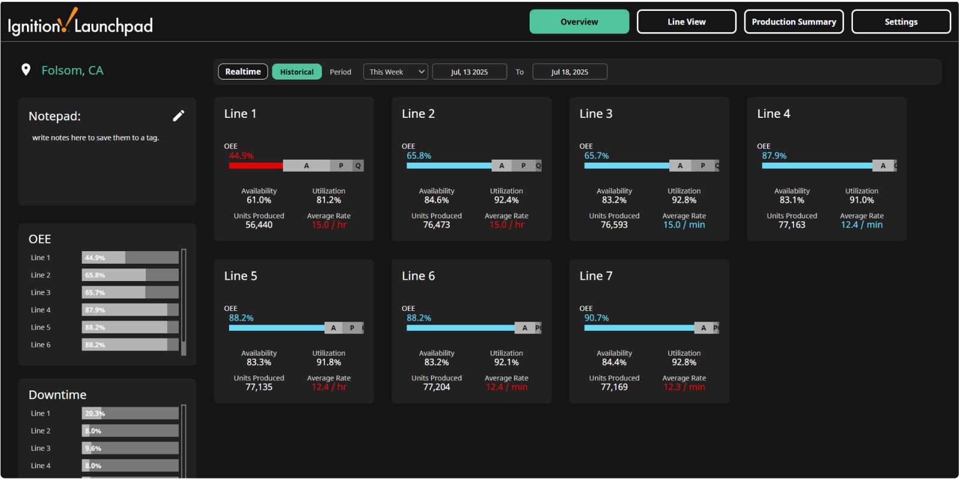
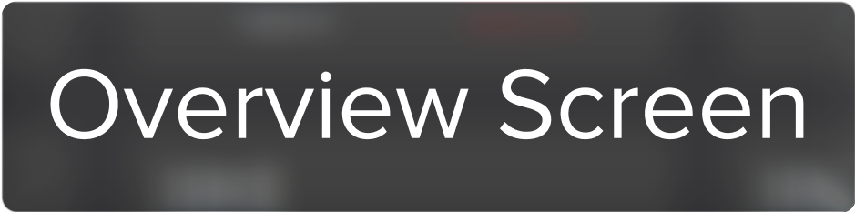
08
Notes:
Let’s dive into each of the screens.
The overview screen shows production data for each line that can be toggled between realtime and historical information.
OEE and Downtime percentages are also compared on the side of the screen for each line.
It’s easy to add any number of Line Cards to match your operations. These cards give you automatically populated data to show each line’s status (Running, Faulted, or Stopped), current and target rate details, production counts, and will additionally display Availability, Performance, and Quality metrics while hovering.

Slide 9
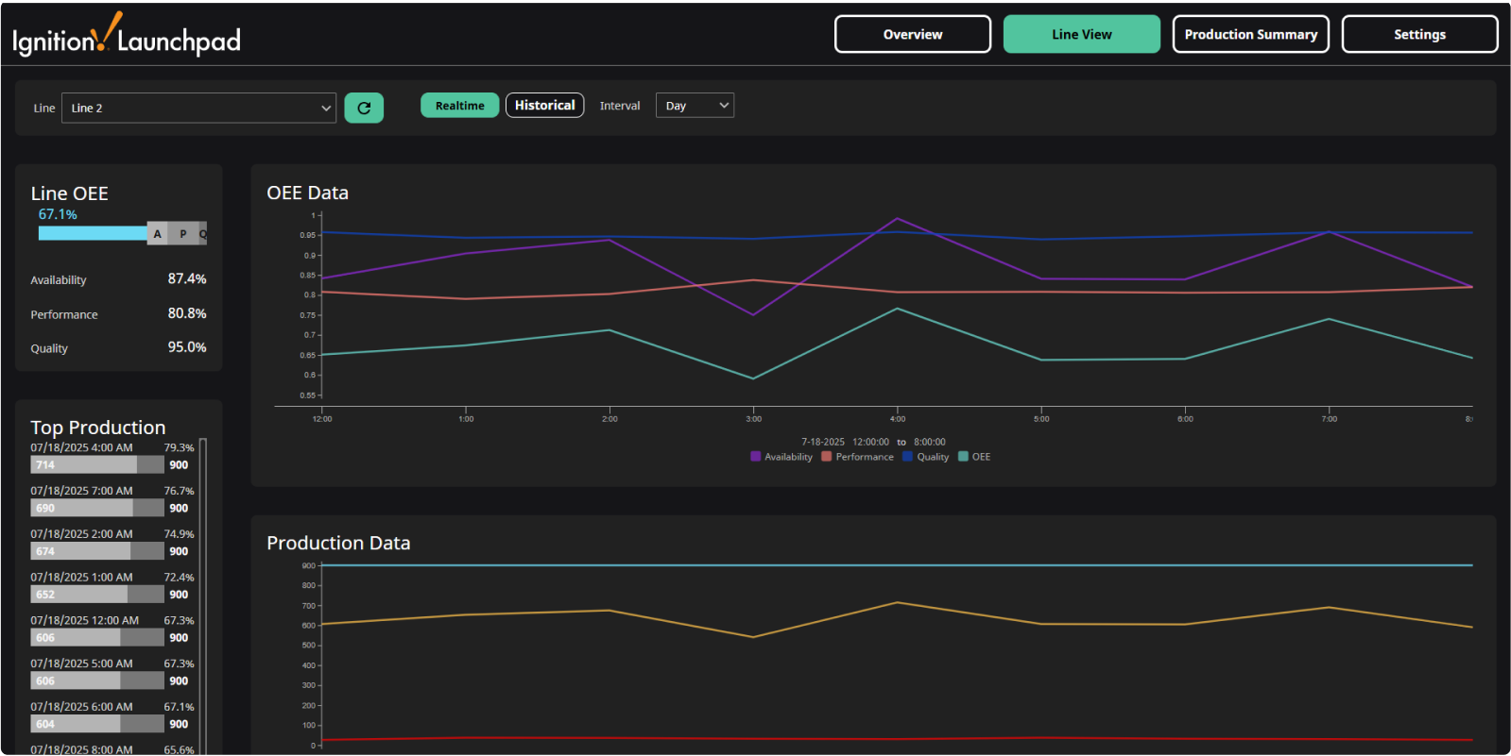

09
Notes:
The Line View screen gives you access to hourly trending data for the selected line in an OEE Data chart and a Production Data Chart along with an hourly bar chart showing the most productive hours in the selected time period.
You can also hover your mouse over any point within either of the charts, to show availability, performance, quality, and OEE metrics for that specific time.
With just a quick glance, you can immediately see where OEE and Production drop-offs or upticks occur for a particular day, shift, or hour over any period of time.

Slide 10
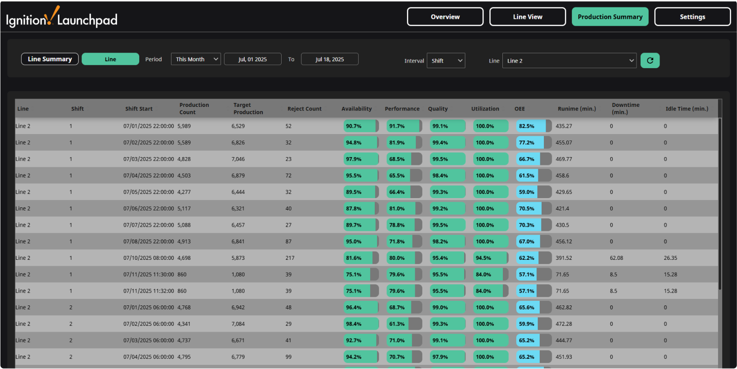

10
Notes:
The Production Summary screen offers an even closer look into your lines’ historical data.
You can toggle between the Line Summary mode to show a summary across all lines for the selected time period.
Or use the Line mode view to show any number of lines over the selected period, displaying additional data for different intervals like day, shift, or hour.
This gives you an in-depth understanding into which lines are producing well, or those that aren’t meeting expectations — giving you real data to make continuous improvements.

Slide 11
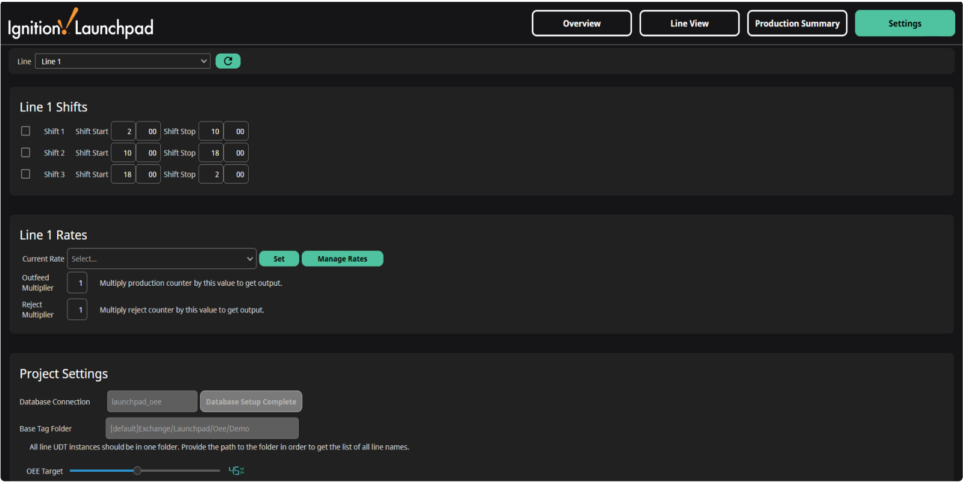

11
Notes:
All of this is easily configurable in the Settings screen, where line by line you can set up shifts and target production rates.

Slide 12
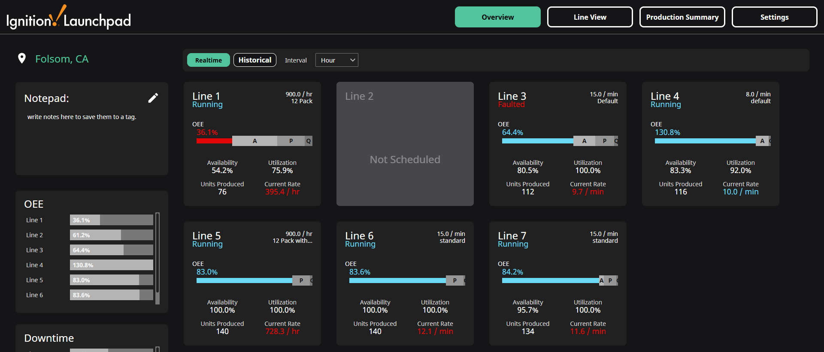
Transform Your Processes
12
Notes:
With a multitude of ready-to-use features, the Ignition OEE Project can immediately transform your processes.
This application is built to integrate directly with the plant-floor, allowing you to see your real-time data down to the millisecond.
It's easily adaptable to any industry and doesn't require a full-scale overhaul of your current SCADA software. Ignition can easily be layered on top of your current system, providing immediate advantages without disrupting ongoing operations.

Slide 13
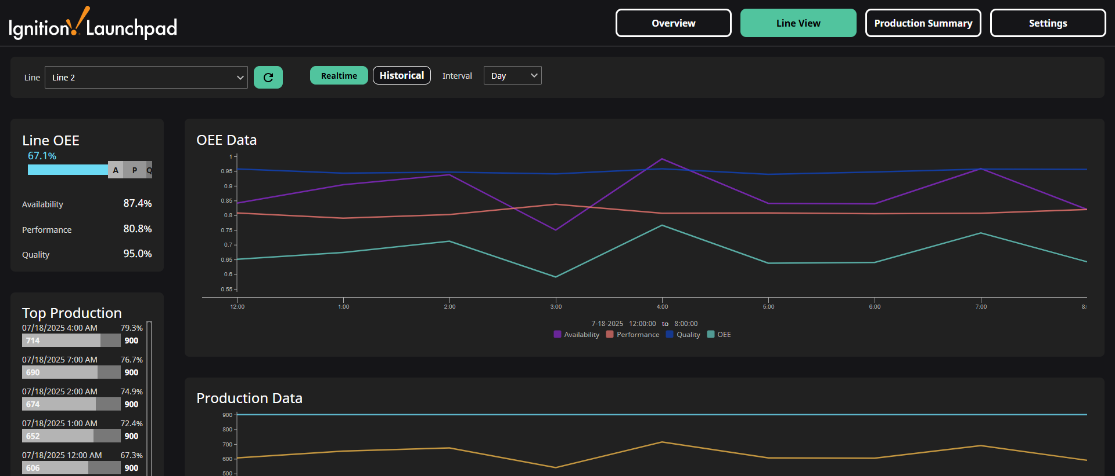
Let’s Look At Your Application
14
Notes:
[Demo]

