Slide 1




Track and Analyze KPIs
With One Easy-To-Use Interface
Complete Ad-Hoc Dashboard
Filter Time Frames
& Intervals
User-Friendly and Responsive Interface
01
Notes:
Today I want to show you the Ignition Launchpad KPI Dashboard: an easy-to-use, plug-and-play application that provides instant access to all your real-time and historical data through a user-friendly, factory-ready, and fully responsive interface.

Slide 2
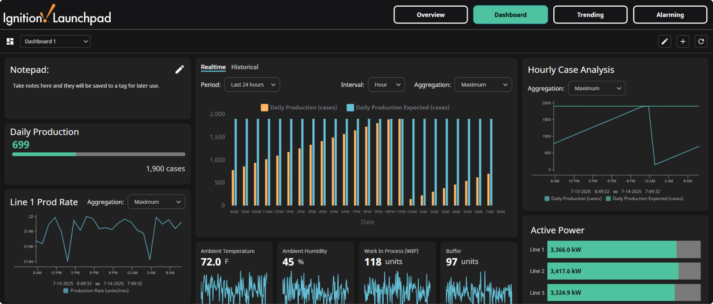

Your Real-Time Data...Visualized
02
Notes:
This dashboard enables continuous improvement and troubleshooting by allowing users to filter time frames and intervals of their KPIs.
It's pre-built and ready to be easily integrated with your equipment’s data to start streamlining and improving your processes.
Instead of manually entering and monitoring KPIs through programs like Excel or PowerBI, you can assess real-time and historical KPIs with a click.
But before we get deeper into this dashboard, let's talk a little about the software it's built with.

Slide 3














Powered By
The Industrial Automation Platform
Unlimited Licensing Model
Server-Centric Web-Deployment
Modular
Configurability
Cross-Platform Compatibility
Connects To Any Major
PLC & Database
Universal Designer
Built on Open Standard Technologies
Rapid Development and Deployment
03
Notes:
Ignition is an industrial automation platform that enables you to collect all your data, design any kind of industrial application, and instantly web-deploy clients to anyone, anywhere — without limits.
Developed by Inductive Automation, the platform is built upon several unique features for the automation software space:
An unlimited licensing model that really is unlimited — we'll dive more into that shortly.
A server-centric web-deployment model that empowers you to integrate Ignition into flexible, scalable SCADA architectures.
Ignition has a full range of software modules to develop virtually any kind of industrial application.
It can be installed on any major operating system including mobile OSes like iOS and Android.
Ignition comes with a bundle of drivers for easy connection to any major PLC & Database.
It features an integrated designer tool to with an easy-to-use interface, endless customization, and includes unlimited design clients.
Ignition is built on trusted open technologies like SQL, Python, OPC UA, and MQTT.
The platform gives you all the tools and drivers you need in one place to rapidly develop and deploy any application.

Slide 4



Unlimited Tags
Unlimited Screens
LICENSING MODEL
What’s In
Unlimited?
Unlimited Users
Unlimited Connections
04
Notes:
So what's in Ignition's unlimited licensing model?
Some industrial automation software companies still charge for every client and every tag.
Ignition is different. It's is sold by the server and one server license gives you an unlimited number of clients, tags, and connections so you can build the exact system you need.

Slide 5
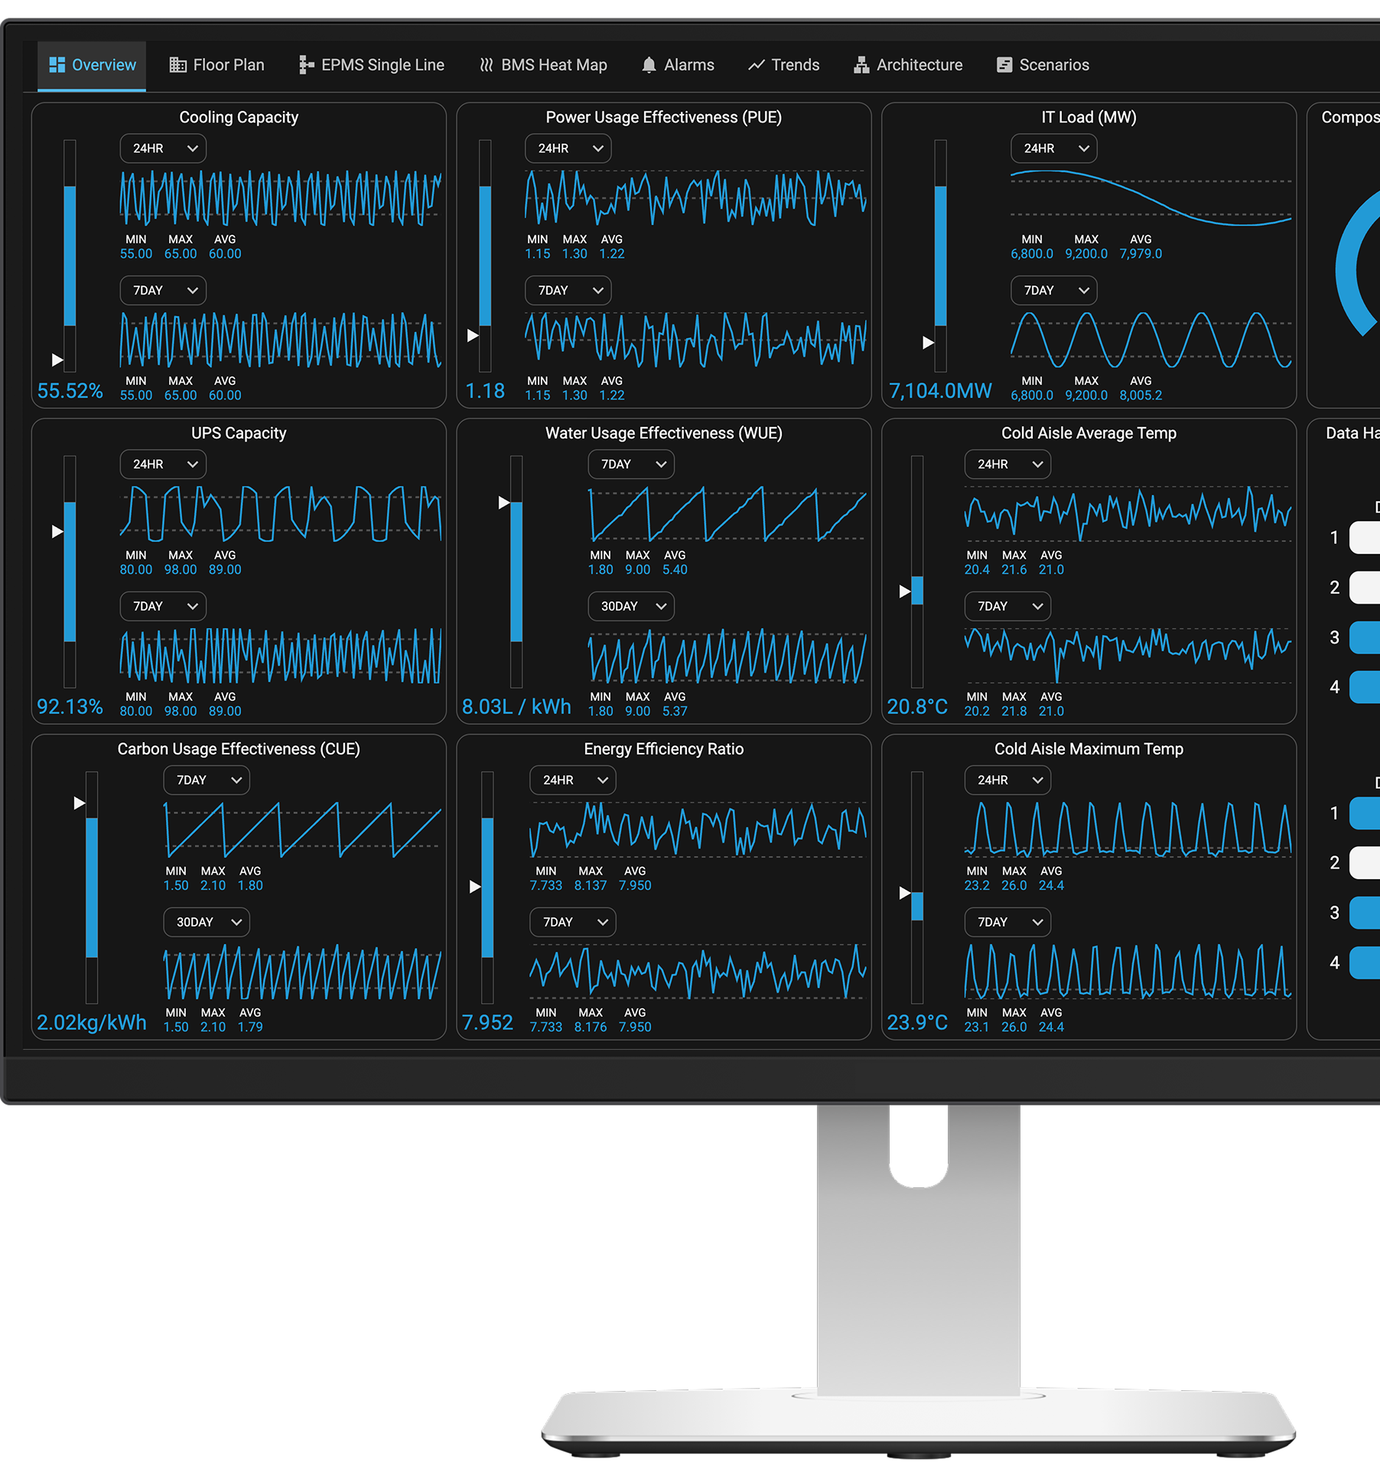
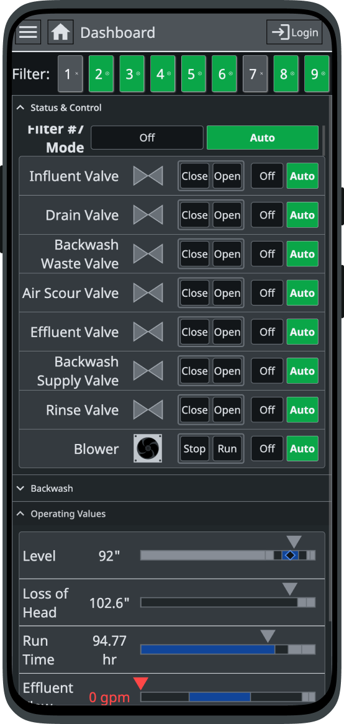
Rapidly Build Any
Industrial Application
SCADA, HMI, MES, Enterprise, Digital Transformation, Data Ops, IIoT, and More
Water/Wastewater, Automotive, Data Centers, Manufacturing, Solar, Oil & Gas, Pharmaceuticals, Food & Bev, and More
Fast and Easy Development
Flexible and Scalable Architectures
Notes:
Ignition is also not a pre-set software package that's only viable for a specific set of use cases.
With the platform, you can pick and choose modules built by Inductive Automation to configure the exact solution you need — from SCADA, HMI, and MES applications to IIoT, UNS solutions, Data Ops, and more.
And because of its modular and server-based structure, you can easily add features and scale your architecture as you go.
The customization, flexibility, and affordability it offers is why Ignition is used in practically every industry, from Water/Wastewater to Pharmaceuticals.

Slide 6

















Trusted By Thousands of Companies Across the Globe
06
Notes:
Ignition and Inductive Automation are widely beloved by integrators and users alike because of their dedication to solving pain points and simplifying the development of diverse automation solutions.
With installations in over 140 countries, Ignition has been adopted globally and is used by 65% of Fortune 100 companies.

Slide 7








Back To Your Data...
[Company Name’s] KPI Dashboard
Complete Ad Hoc Dashboard
Access Multiple
KPI Types
Trending & Alarming
Tools
Customize With
A Click
Realtime and
Historical Data
Mobile Responsive
Interface
Make Data Accessible
to Everyone
Flexible For Any
Use Case
07
Notes:
And now that you know a little bit about Ignition, let's dive deeper into this KPI Dashboard built with Ignition.
This plug-and-play application is ready to use and comes with multiple features and widgets for monitoring KPIs.
It features a robust ad hoc dashboard with both real-time and historical information.
The KPI types encompass a range of metrics, from those applicable across an entire site to specific measurements like a single production line's performance.
It also includes an extensive ad hoc trending tool for ongoing analysis, alongside an alarming tool for configuring alarms and notifications.
The dashboard allows you to quickly view different intervals of historical data, to monitor processes over time or for troubleshooting purposes.
The interface is fully responsive, so you can view this dashboard on any HMI, screen, or mobile device.
And because it's Ignition, it comes with unlimited users so you can access this application from any number of screens or devices.
Ignition's flexibility allows this application to be used for any type of use case.

Slide 8



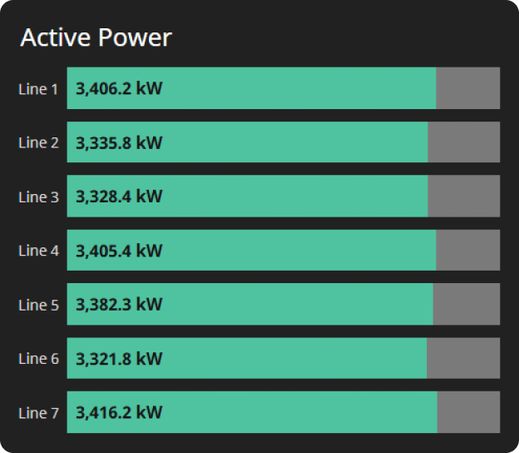
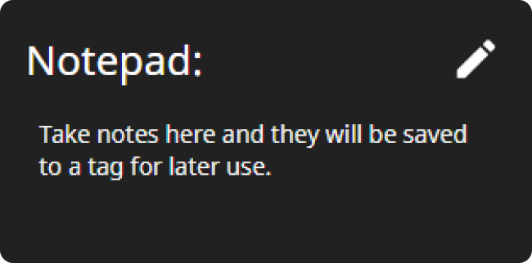
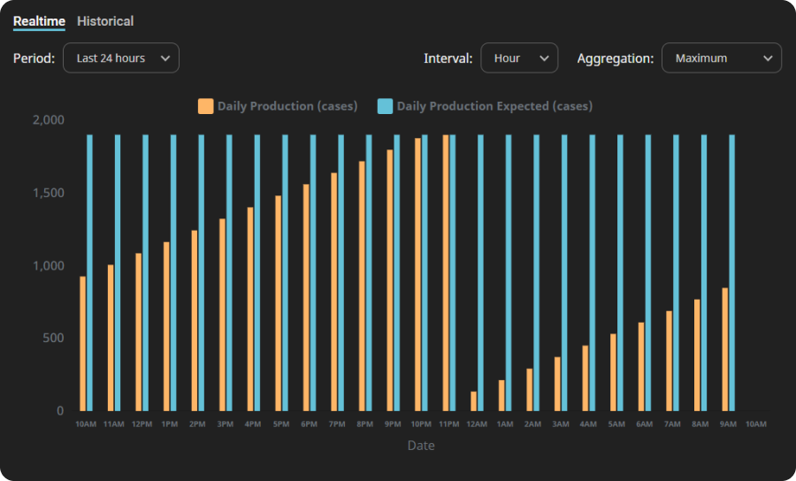




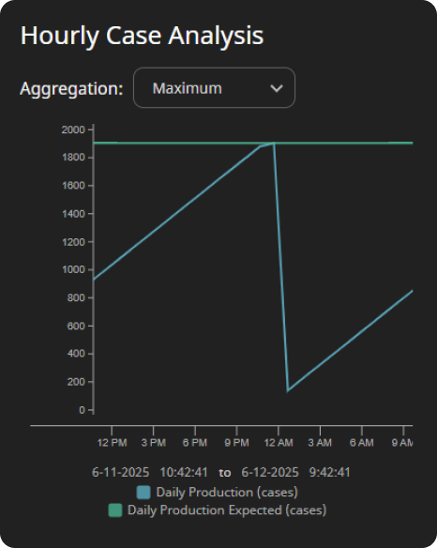
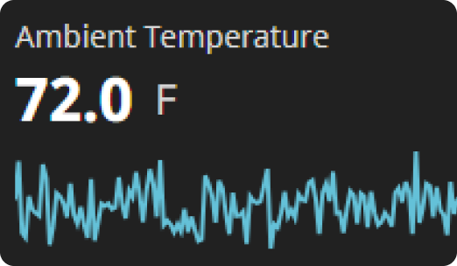
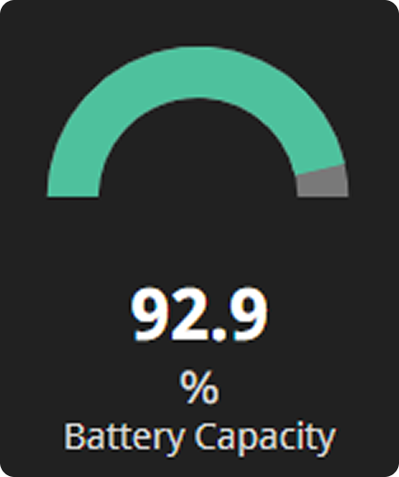
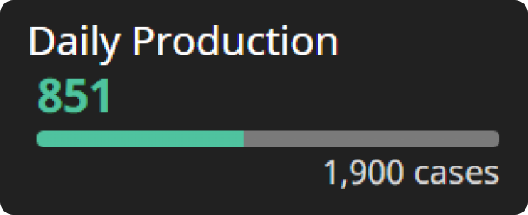
Add Widgets With Ease
Display one KPI from all the available lines or areas or pieces of equipment.
Display actual & expected production counts.
Allow users to take notes visible to anyone viewing the dashboard.
Display KPI trends vs the expected target.
Display a numerical value from a tag on a moving gauge.
Display how close the site
is to hitting the expected target.
Display the current value, along with a trending line for the last 24 hours.
08
Notes:
As I mentioned the dashboard comes ready-to-go with multiple KPI types. Here's a look at some of the widgets that can be immediately integrated with your system.
Progress KPI: This component displays one KPI from all the available lines or areas or pieces of equipment.
Notepad: The Notepad component allows users to take notes that will be seen by anyone else looking at this dashboard.
Bar Chart: The Bar Chart component displays actual and expected production counts that can be filtered and toggled between Realtime and Historical data.
Line Chart: The Line Chart component displays actual and expected production counts.
Sparkline: The Sparkline component displays the current value, and includes a trending line that visualizes how the value changed during the last 24 hours.
Simple Gauge: The Simple Gauge component displays a numerical value from a tag on a moving gauge.
Daily Production: The Daily Production component displays how close the site is to hitting the expected target.

Slide 9
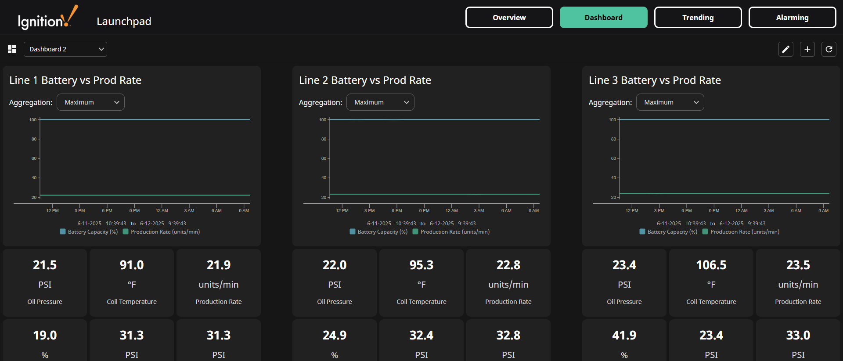
Transform Your Processes
09
Notes:
With a multitude of ready-to-use features, the Ignition KPI Dashboard can immediately transform your processes.
This application is built to integrate directly with the plant-floor, allowing you to skip any manual data entry and see your real-time data down to the millisecond.
It's easily adaptable to any industry and doesn't require a full-scale overhaul of your current SCADA software. Ignition can easily be layered on top of your current system, providing immediate advantages without disrupting ongoing operations.

Slide 10
Let’s Look At Your Dashboard
10
Notes:
[Demo]

